Slide 1

Probability and Statistics
Han Min(hanm@bjut.edu.cn)
Office：3414 The Second Experimental Building
College of Applied Sciences
Beijing University of Technology
100124, Beijing P. R. China

Slide 2


Review
Expectation
Numerical
Characteristics
Variance

Slide 3
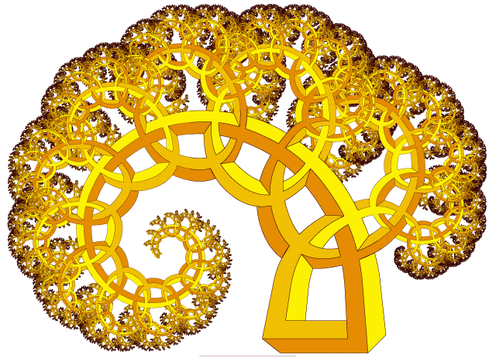
Chapter 4. Numerical Characteristics
of Random Variables
4.1 Mathematical Expectation
4.2 Variance
4.3 Covariance and Correlation Coefficients

Slide 4
Contents
4.3 Covariance and
Correlation Coefficients
Covariance
Covariance
4.3.1
Correlation Coefficients
4.3.2

Slide 5
4.3.1 Covariance
Definition 4.3.1
Covariance
Let (X,Y) be a two-dimensional ,
if E{[ X-E(X)][Y-E(Y)]} exist,
then it is called the covariance of X and Y,
denoted by Cov(X,Y),
Cov(X, Y) = E{[ X-E(X)][Y-E(Y) ]}.
Particuarly,
Cov(X, X) = E{[ X-E(X)][X-E(X) ]}=
D(X).

Slide 6
4.3.1 Covariance
Theorem 4.3.1
The covariance of r.v. has properties as follows:
1
Cov(X, Y) = Cov(Y, X)；
2
let a,b be constants, then
Cov( aX, bY ) = ab Cov(X, Y) ；
Cov( X, a ) = 0 ；
3
Cov(X₁+X₂, Y)= Cov(X₁, Y) + Cov(X₂, Y)；
4
Cov(X, Y) =E(XY)-[E(X)][E(Y)] ，
if X and Y are independent, then
Cov(X, Y)=0；
5
D(X+Y)=D(X)+D(Y)+2Cov(X, Y) .

Slide 7
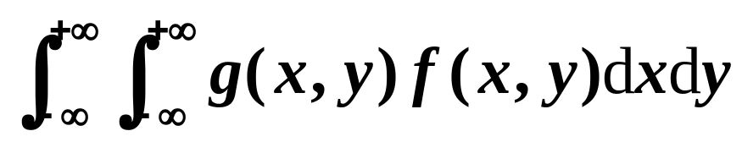
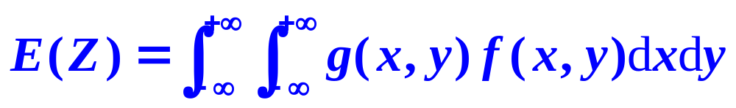
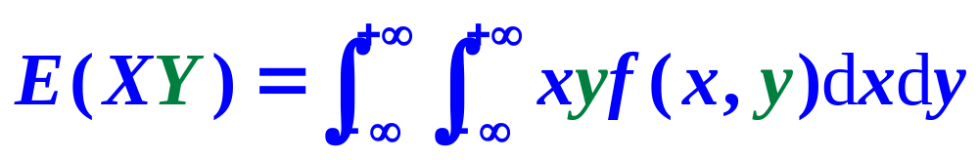
4.3.1 Covariance
Theorem 4.3.2
Cov(X, Y) =E(XY)-[E(X)][E(Y)]
Let Z=g(X,Y) be a function of the r.v. (X,Y) ,
whose joint density function is f(x,y), and
g(x,y) is a continuous function,
if
is absolutely convergent, then,
Z=g(X,Y)=XY

Slide 8
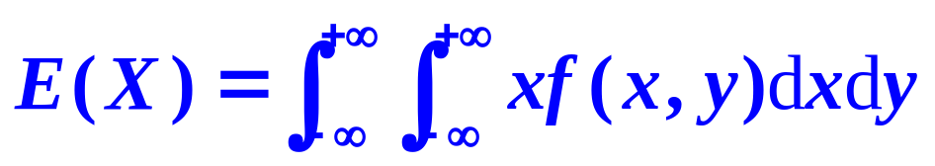
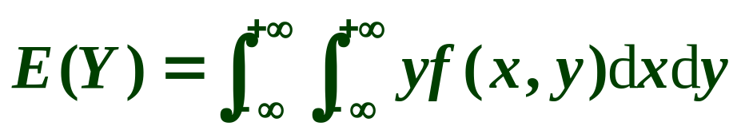
4.3.1 Covariance
Definition 4.3.2
Let (X,Y) be a two-dimensional continuous r.v.,
if E(X), E(Y)exist, then

Slide 9
4.3.1 Covariance
Example 1
Suppose that Y is a linear function of the r.v. X,
Y=5X+6.
D(X)=3.
Find Cov(X, Y).
Cov(X, Y)=15
Cov(X₁+X₂, Y)= Cov(X₁, Y) + Cov(X₂, Y)；
Cov( aX, bY ) = ab Cov(X, Y) ；
Cov( X, a ) = 0 ；

Slide 10
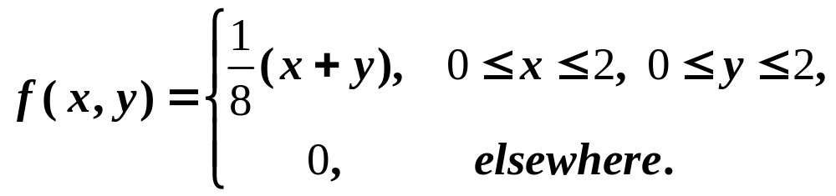
4.3.1 Covariance
Example 2
Cov(X, Y) =E(XY)-[E(X)][E(Y)]
D(X+Y)=D(X)+D(Y)+2Cov(X, Y)
If the joint probability density of two r.v. is given by
Find
1
Cov(X, Y);
Cov(X, Y)=-1/36
2
D(X+Y).
D(X+Y)=5/9

Slide 11
Contents
4.3 Covariance and
Correlation Coefficients
Covariance
4.3.1
Correlation Coefficients
Correlation Coefficients
4.3.2

Slide 12
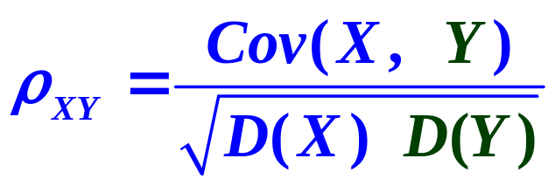
4.3.2 Correlation Coefficients
Definition 4.3.2
Correlation Coefficient
Suppose Cov(X,Y) exist and the variance D(X) and D(Y) are positive, then
is called the correlation coefficient of X and Y.

Slide 13
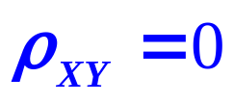
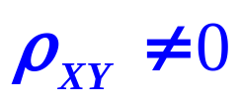
4.3.2 Correlation Coefficients
Definition 4.3.3
If the correlation coefficient of X and Y is
then they are said to be uncorrelated;
If the correlation coefficient of X and Y is
then they are said to be correlated.

Slide 14
4.3.2 Correlation Coefficients
Theorem 4.3.2
If X and Y are
independent,
If X and Y are
uncorrelated,
they are
uncorrelated.
they are
independent.
?

Slide 15



4.3.2 Correlation Coefficients
Example 3
Correlated:
Uncorrelated:
Let the probability distribution of the r.v. X be
X
-1
0
1
P
and Y=X² , discuss
1
whether X and Y are correlated;
No
whether X and Y are dependent.
2
Yes

Slide 16


4.3.2 Correlation Coefficients
Theorem 4.3.3
Let be the correlation of coefficient of X and Y,
1
|ρ|=1
If and only if P{ Y = a+bX } = 1,
2
where a,b are constants.

Slide 17

Typical Examples
Know pij
Find E(X), D(X)
Let X ∼ B(1, p), 0 < p < 1.
Find

Slide 18
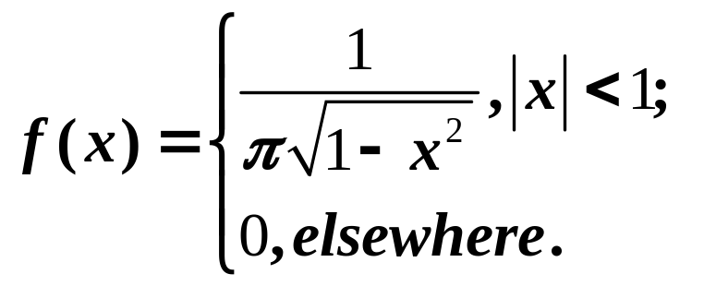
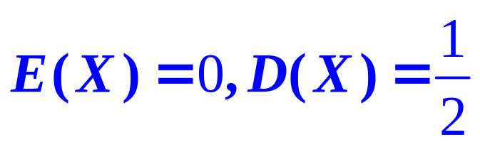
Typical Examples
Know f(x)
Find E(X), D(X)
If the probability density of r.v. X is given by
Find

Slide 19
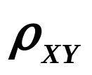
Typical Examples
Know f(x,y)
Find Cov(X,Y), ρ
If the joint probability density of two r.v. is given by
Find
Cov(X, Y)=-1/36
1
Cov(X, Y);
2
D(X+Y);
D(X+Y)=5/9
3

Slide 20




Typical Examples
Know pij
Find E[g(X)]
If the law of probability distribution of the r.v. X is
 | -2 | 0 | 1 | 3
p
X
Find

Slide 21
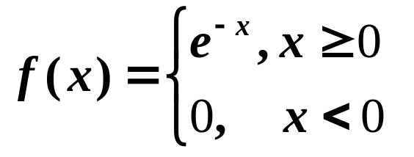
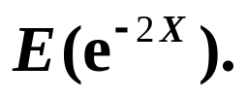
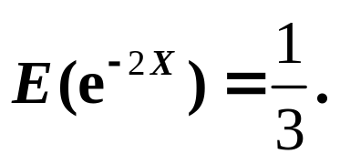
Typical Examples
Know f(x)
Find E[g(X)]
If the probability density of r.v. X is given by
Find

Slide 22
Chapter 5. Law of Large Numbers
and Central Limit Theorem
5.1 Law of Large Numbers
5.2 Central Limit Theorem

Slide 23
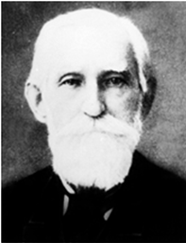
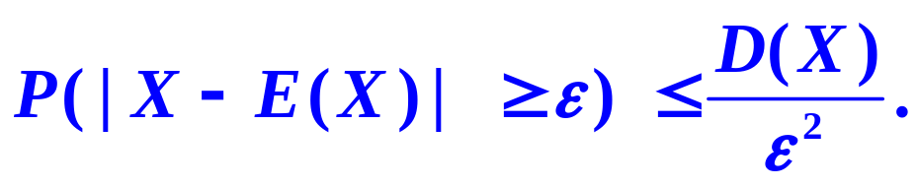
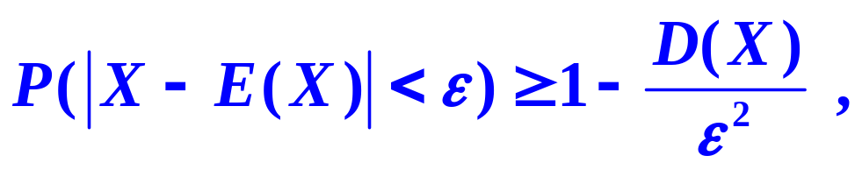
5.1 Law of Large Numbers
Theorem 5.1.1
Chebyshev Inequality
If the variance D(X) of the r.v. X exists, then,
for any X>0, we have
or

Slide 24
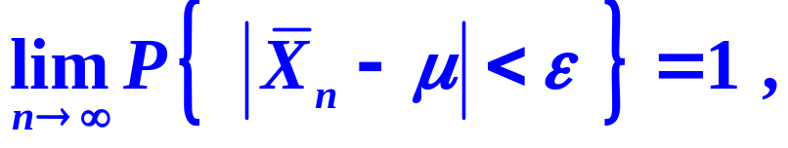
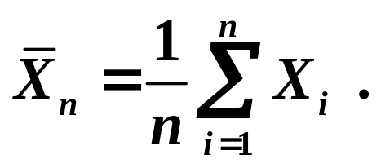
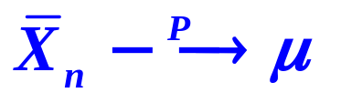
5.1 Law of Large Numbers
Theorem 5.1.2
Chebyshev’s Law of Large Numbers
Let the r.v. X₁, X₂, …, X_{n}… be mutually
independent, with the same distribution,
E(X_{i})=μ, D(X_{i}) =σ²，i=1, 2, …
then for any ε>0,
where

Slide 25
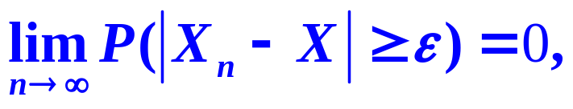
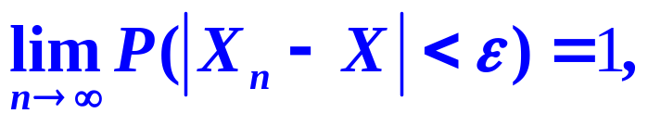
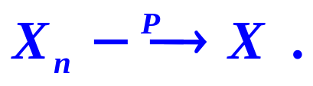
5.1 Law of Large Numbers
Definition 5.1.1
Let X₁, X₂, …, X_{n}… be a sequence of r.v.,
if there exists a r.v. X such that, for any X>0,
we have
or
then it is said that the sequence {X_{n}} converges to
the r.v. X in probability , denoted by

Slide 26
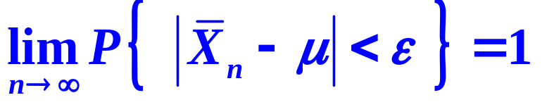
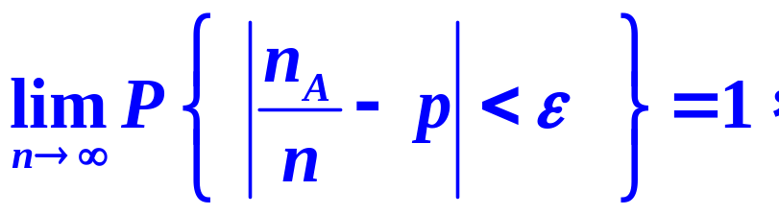
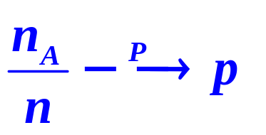
5.1 Law of Large Numbers
Theorem 5.1.3
Bernoulli’s Law of Large Numbers
Let n_{A} be the time of occurrences of event A
in n Bernoulli experiments,
and p denotes the
probability that A occurs in each experiment,
then for any ε>0,
we have

Slide 27
Chapter 5. Law of Large Numbers
and Central Limit Theorem
5.1 Law of Large Numbers
5.2 Central Limit Theorem

Slide 28
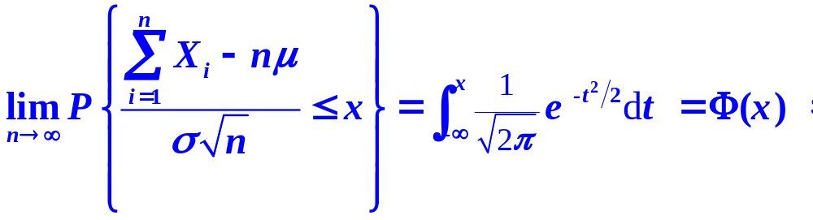
5.2 Central Limit Theorem
Theorem 5.2.1
Central Limit Theorem for Independent Identical Distribution
Let the r.v. X₁, X₂, …, X_{n}… be mutually
independent, with the same distribution,
E(X_{i})=μ, D(X_{i}) =σ²，i=1, 2, …
then for any x ∈(-∞, ∞),

Slide 29
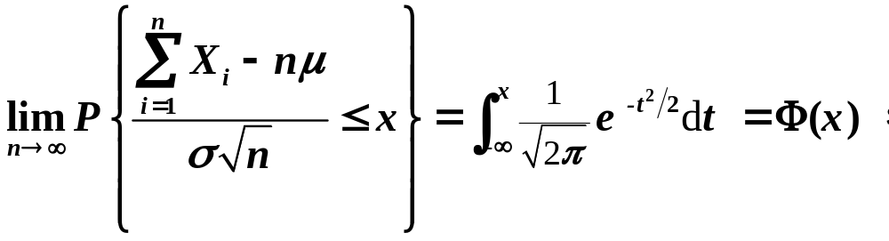
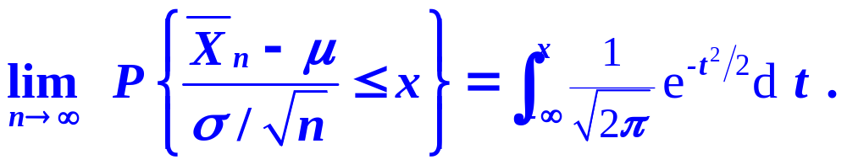
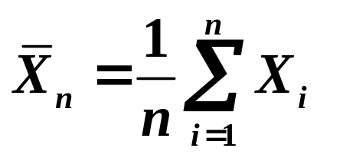
5.2 Central Limit Theorem
where

Slide 30
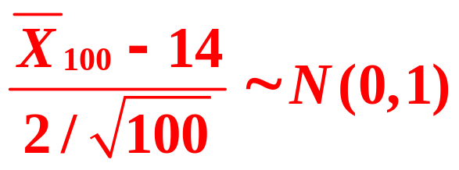
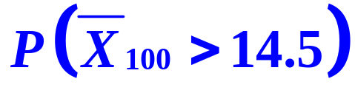
5.2 Central Limit Theorem
Example 1
Let the tensile strength of a batch of product
follow the distribution with the expectation 14
and the variance 4.
There are 100 these products.
Find the probability that average strength more than 14.5.
0.0062
Solution:
X_{i} : strength of i-th product

Slide 31
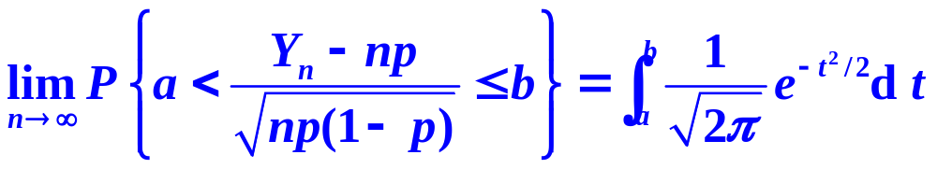

5.2 Central Limit Theorem
Theorem 5.2.2
De Moivre-Laplace Theorem
Suppose r.v. Y_{n} follows B(n, p) , then,
for any interval (a,b).

Slide 32
5.2 Central Limit Theorem
Example 2
Suppose there are 10000 bulbs in an electricity supply net,
the probability of turning on each bulb
is 0.7, let the time for turning on and the time for turning off be mutually independent,
calculate the probability that about 6800-7200
bulbs are turning on simultaneously.

